Slide 1



Desktop Application for simulation of Host functionality for Platform for communication Adapter (PCA)
Presented By
K TATA RAO

Slide 2
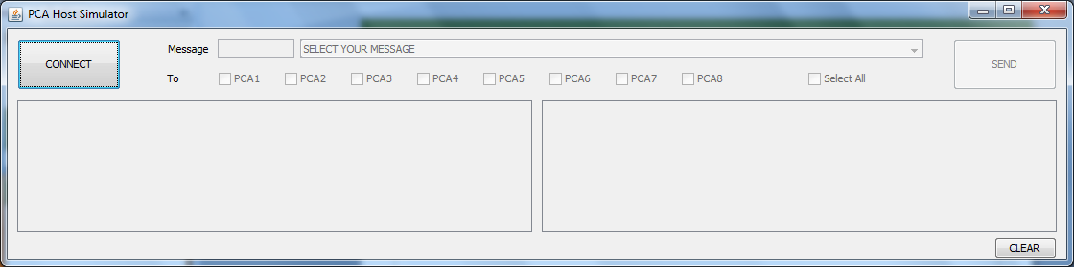
How GUI looks When Start
When Application started, the GUI looks like below. Initially, CONNECT button only enabled in order to guide the user that he has to connect with a PCA device.

Slide 3
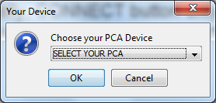
Choose your PCA device
When User pressed on CONNECT button, you are able to Select PCA device from a PCA list displayed by a InputDialogBox.
If you clicked on Cancel, the UI window gets closed. If you clicked on Ok button without selecting PCA from list, the same dialog box displayed continuously until you selected a PCA.

Slide 4
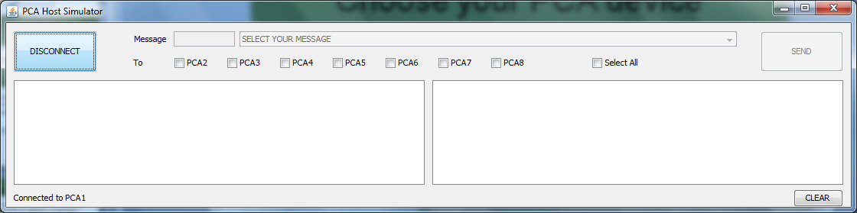
Connected to your PCA device
Once you selected your PCA, and then clicked on Ok, you are now connected to respected PCA, the same status can be shown at left-bottom label and CONNECT button state change to DISCONNECT. Connection status is visible to you, until you clicked on DISCONNECT state of button.
Checkbox labels updated based on the selection.
TCP socket connection started and receiving thread started to receive response .
Until you select at-least one PCA checkbox, Message components such ass Message ID textfield, and Message combobox will be in disable state.

Slide 5
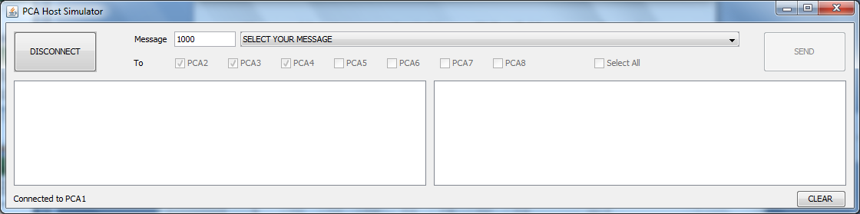
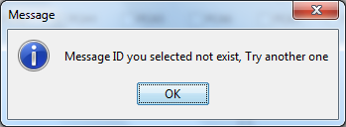
Selecting destination PCAs
User was able to type a number in MessageID Textfield corresponding to the message of his choice when you pressed enter the same selected in the combo box next to it.
If the entered number is not existed in your text file, it displays an alert box and clears both Message components to default state when we click OK button. And you now able to reselect your message.

Slide 6
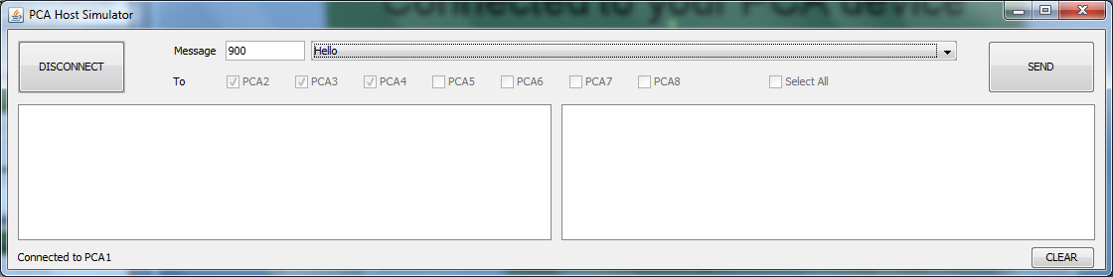
Selecting destination PCAs
After selecting PCA(s), all checkboxes disabled,MessageID Textfield and Message combobox get enabled and allow you to select MessageId and Message. (All messages stored in a text file named as Message.txt and populated to the combobox when application starts. User shall edit the text file to add/remove/modify the messages.)
The SEND button disabled until you selected a message. After you selected a message SEND button enabled and you are able to send message to selected PCAs

Slide 7
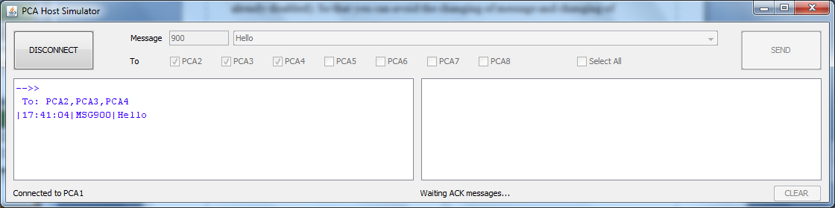
Sending packets
When sending initiated, Message Id Textfield and combobox get disabled (Checkboxes already disabled). So that you can avoid the changing of message and changing of destinations while data is sending and receiving ACKs.
After SEND button clicked, Message Panel-1 displays all messages outgoing from the connected PCA. These messages displayed in required format (Mean to say , includes direction indicator, destination, timestamp , msg id and initial part of message).
When sending is done the source PCA (your connected PCA) waits for ACK from destinations, this status shown at right bottom and starting point of Message Panel-2.

Slide 8
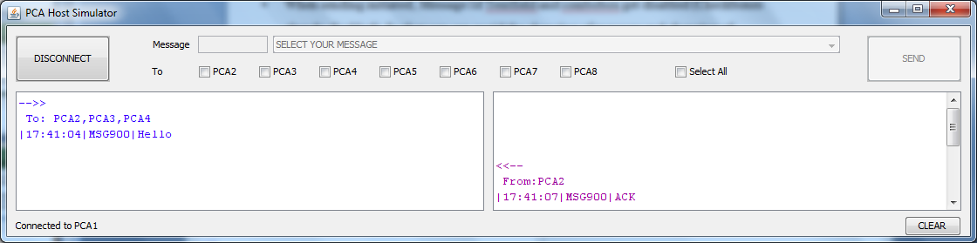
Receiving ACK packets
Message Panel 2 displays all incoming ACK messages to the connected PCA. Displayed messages includes direction indicator, source, timestamp , msg id and initial part of message.
Label right-bottom displays waiting status for ACK messages until it gets all ACK messages from all selected PCA destinations, to which Source PCA sent message.
Both message panels were synchronized with each other for scroll and other operations.
Clear button disabled until sending and receiving messages displayed into message panels in one send.

Slide 9
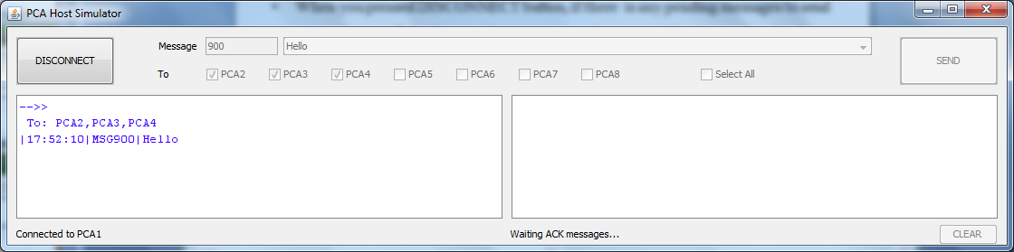
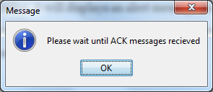
Disconnecting your PCA Device
When you pressed DISCONNECT button, if there is any pending messages to send or receive, it will displays an alert message and waits until that’s completed and then terminates the TCP connection. And clear both message panes. After connect, button changes to disconnect and vice versa.

Slide 10
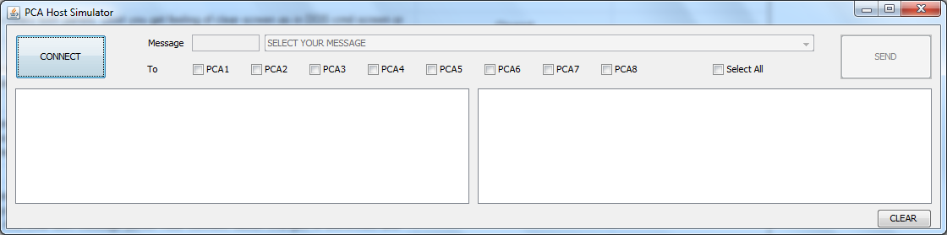
Disconnecting your PCA Device
When you pressed DISCONNECT button, if there is no pending messages to send or receive, then TCP socket connection terminated and DISCONNECT changes to CONNECT state. And clear both message panes. After connect, button changes to disconnect and vice versa.

Slide 11
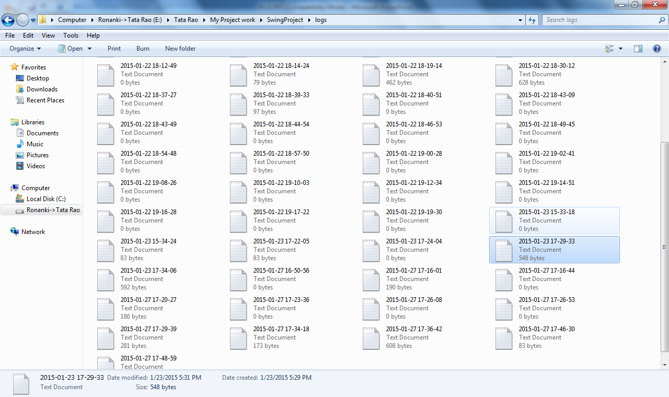
Log file creation
New separate Log text file created for each connection.
Each Log text file had connection timestamp as part of filename.
All incoming and outgoing messages logged to log text file.

Slide 12


